Slide 1
DATA STORY • VISUAL ANALYTICS
TOTAL ORDER VALUE
₹14.98M
Flipkart Sales
Dashboard
TOTAL UNITS
1,398
Enhanced graph types, explained in easy language
DISCOUNT AMOUNT
₹1.98M
Source: uploaded CSV • 1,000 records
Each chart answers a different business question.

Slide 2
01 / QUICK OVERVIEW
Start with the key numbers
The figures below are calculated from the supplied CSV.
RECORDS
QUANTITY
ORDER VALUE
1,000
1,398
₹14.98M
UNIT-PRICE SUM
DISCOUNT AMOUNT
FINAL UNIT-PRICE SUM
₹12.36M
₹1.98M
₹10.38M
Important data note
“Sum of Discount_Percent” adds percentage values together. It is not the average discount rate. Also, unit-price sum is not profit; profit requires cost data.

Slide 3
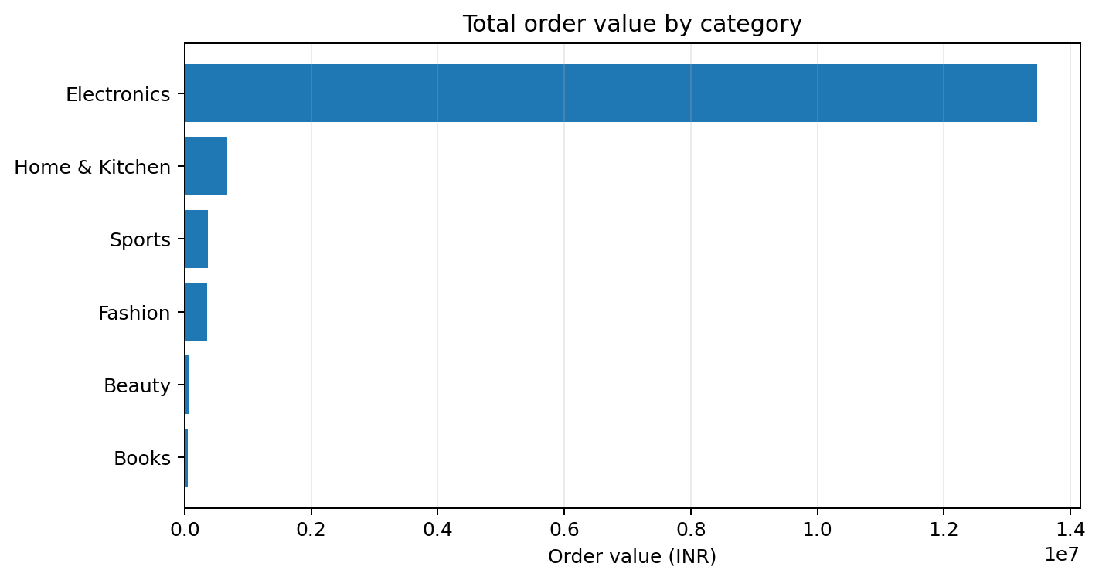
02 / GRAPH 1
Horizontal bar chart: order value by category
Easy explanation: this chart compares the total money recorded for each category.
How to read this graph
Longer bars mean higher total order value.
Electronics is the largest category by a wide margin.
Home & Kitchen is next; remaining categories are much smaller.
Use this to identify which category drives sales value.

Slide 4
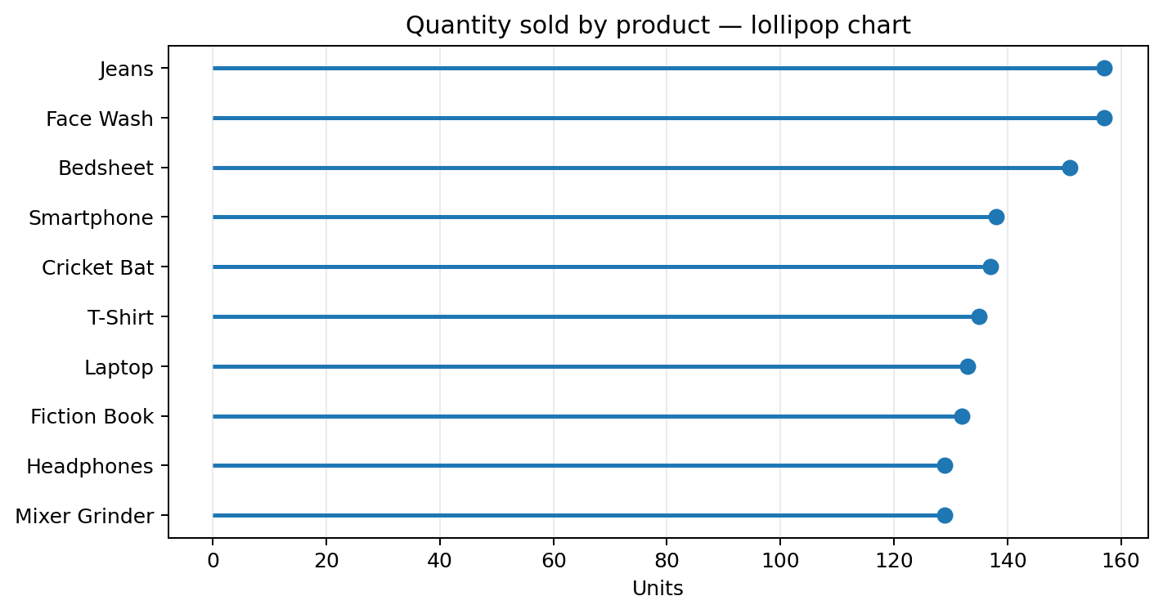
03 / GRAPH 2
Lollipop chart: quantity by product
Easy explanation: this chart shows which products sold the most units.
How to read this graph
Each dot marks the number of units for a product.
Further to the right means more units sold.
Quantity measures volume—not revenue or profit.
Compare this with price/value charts to understand the difference.

Slide 5
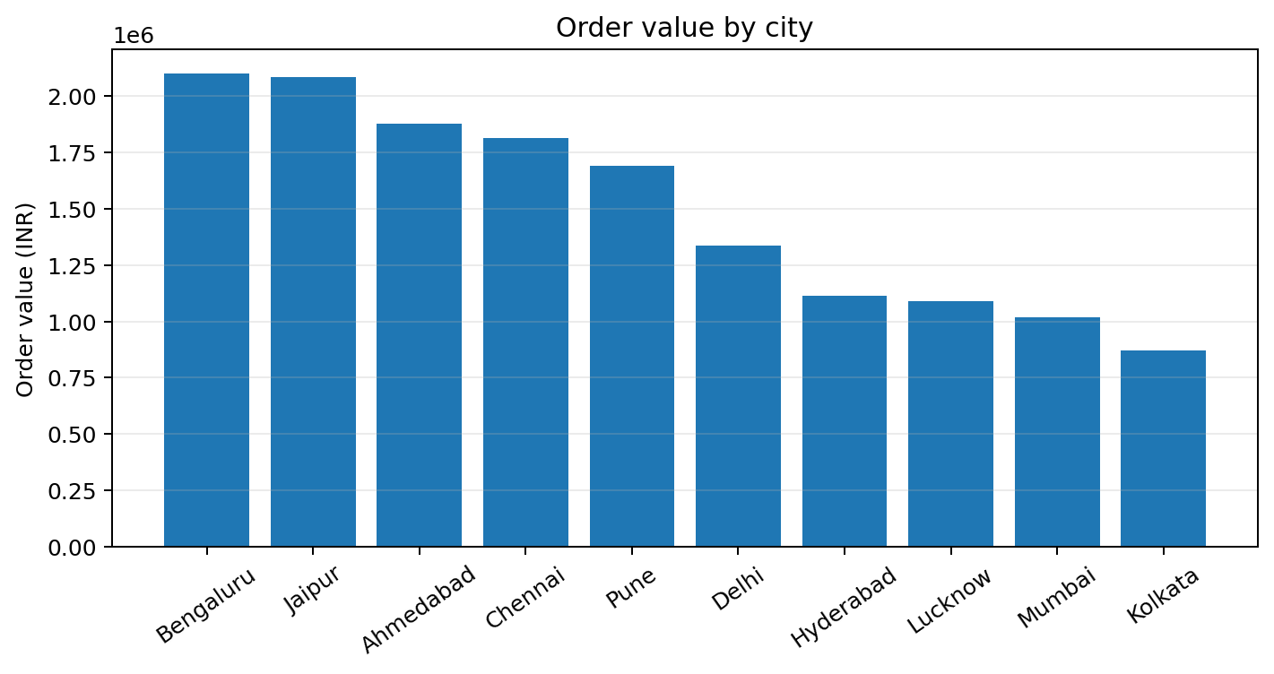
04 / GRAPH 3
Column chart: order value by city
Easy explanation: compare the total value of orders recorded in each city.
How to read this graph
Bengaluru has the highest total order value.
The tallest column means the highest recorded city total.
City totals can reflect order count and order size.
Compare with customer counts before deciding where demand is strongest.

Slide 6
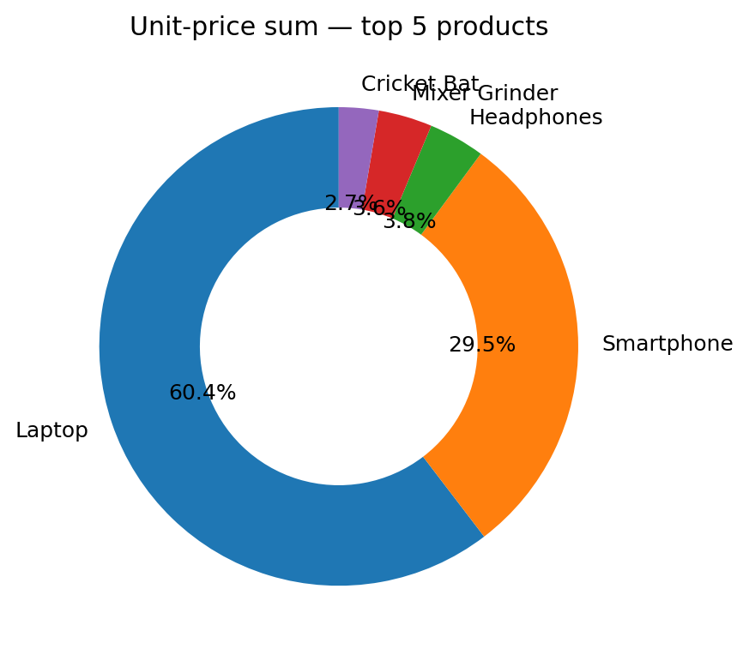
05 / GRAPH 4
Donut chart: product unit-price contribution
Easy explanation: the donut shows how the top products contribute to the summed unit prices.
How to read this graph
Each slice shows one product’s share among the top five.
A larger slice means a larger summed unit-price value.
This is not a profit share or necessarily order revenue.
The chart intentionally focuses on the five highest products.

Slide 7
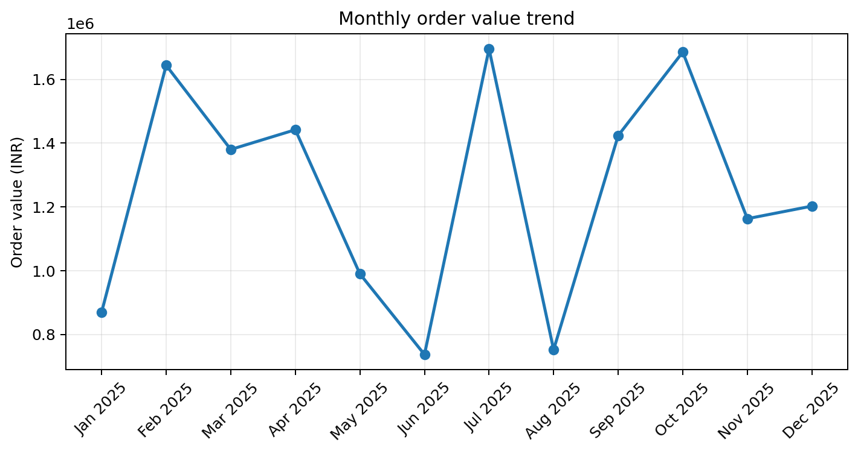
06 / GRAPH 5
Line chart: monthly order value trend
Easy explanation: follow the line to see how recorded sales value changes over time.
How to read this graph
Each point represents one month’s order value.
An upward line means the monthly total increased; downward means it decreased.
Look for peaks and dips to plan campaigns or stock.
One month can change because of order volume or order size.

Slide 8
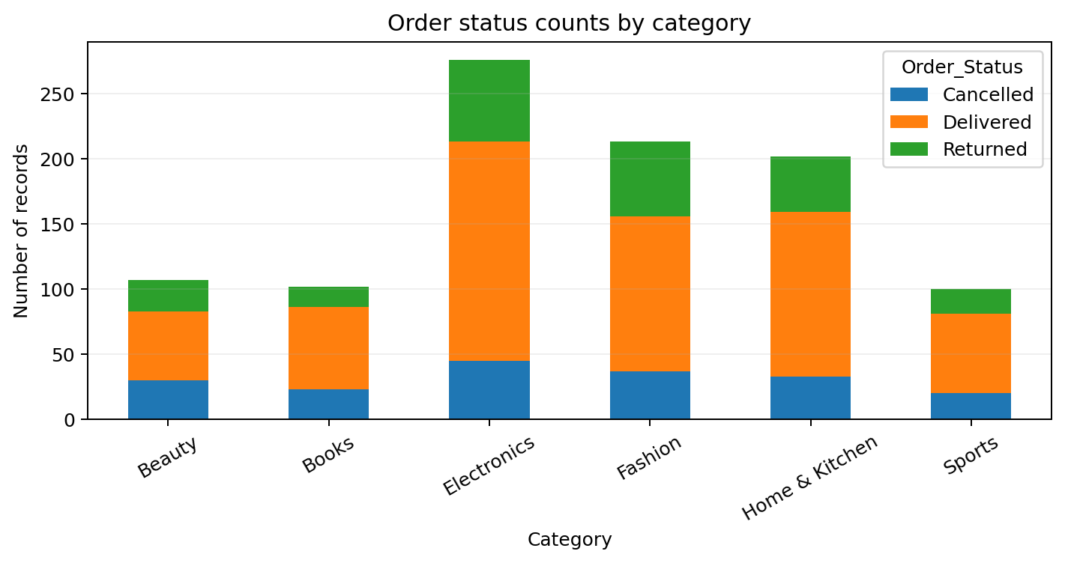
07 / GRAPH 6
Stacked bar chart: order status by category
Easy explanation: this combines category and order status in one view.
How to read this graph
Each full bar represents a category’s record count.
The coloured segments split records by status.
Compare delivered, returned and cancelled counts across categories.
A high count alone does not show return rate; compare percentages too.

Slide 9
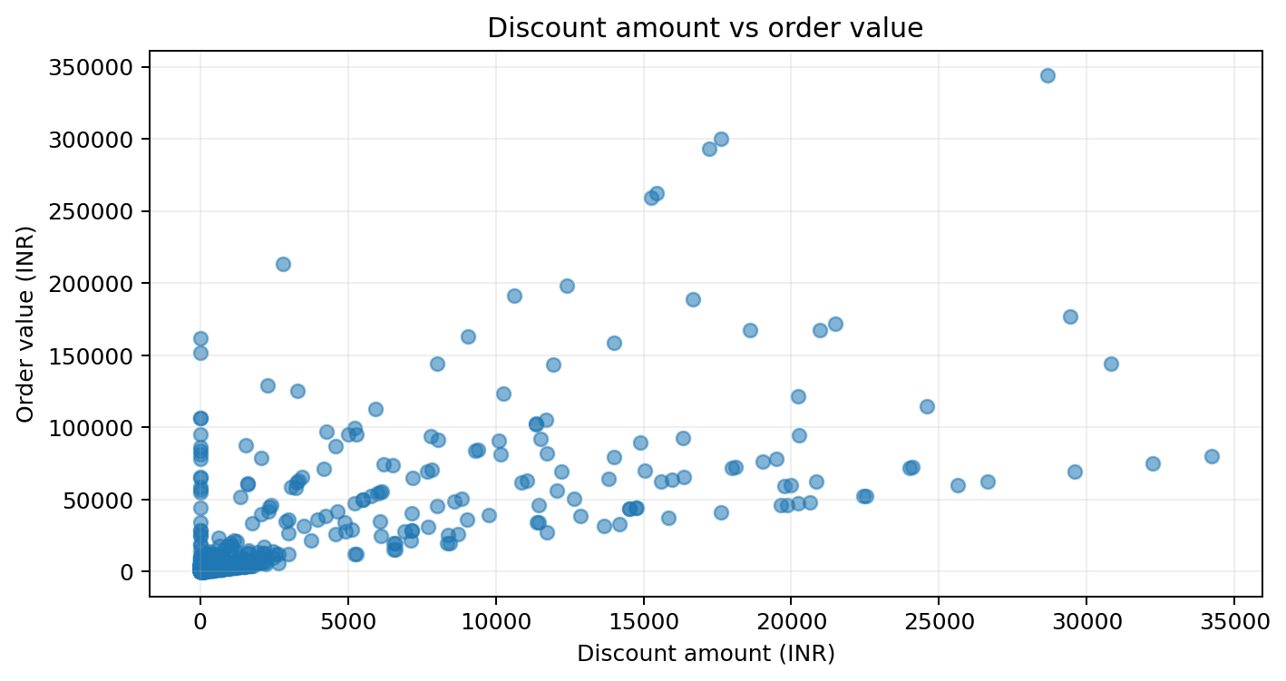
08 / GRAPH 7
Scatter plot: discount amount vs order value
Easy explanation: check whether larger discounts tend to appear with larger order values.
How to read this graph
Each dot is one record/order.
Dots farther right have larger discounts; dots higher up have larger order values.
A rising pattern can suggest larger orders often receive larger discounts.
Scatter shows association, not proof that discounts cause higher sales.

Slide 10
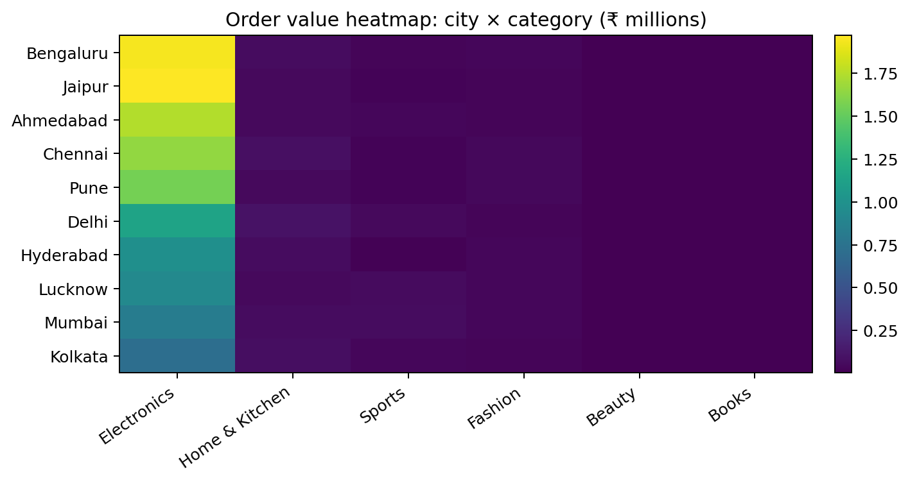
09 / GRAPH 8
Heatmap: city × category
Easy explanation: the colour grid lets you compare many city-category totals quickly.
How to read this graph
Rows are cities; columns are categories.
Darker/lighter intensity indicates lower/higher order value (see scale).
Find city-category combinations with relatively high totals.
This helps spot where a category performs well geographically.

Slide 11
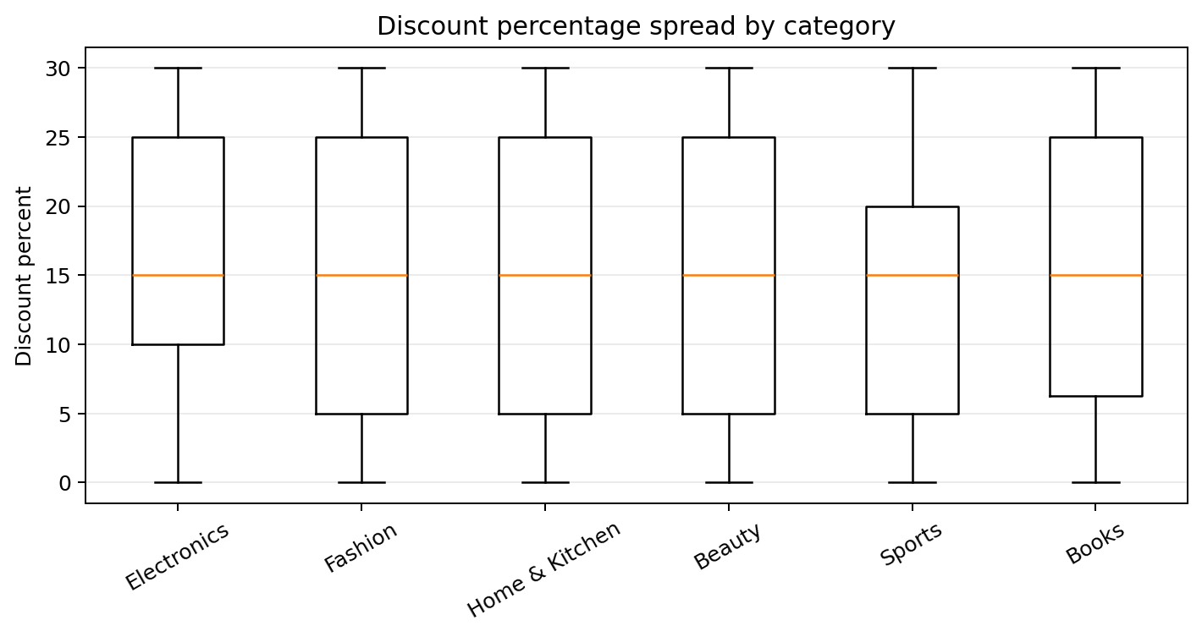
10 / GRAPH 9
Box plot: discount percentage spread
Easy explanation: this shows the typical discount and how much it varies by category.
How to read this graph
The line inside each box is the median discount.
The box shows the middle half of discount values.
Longer boxes mean more variation in discount percentages.
Compare categories to see whether discounting is consistent.

Slide 12
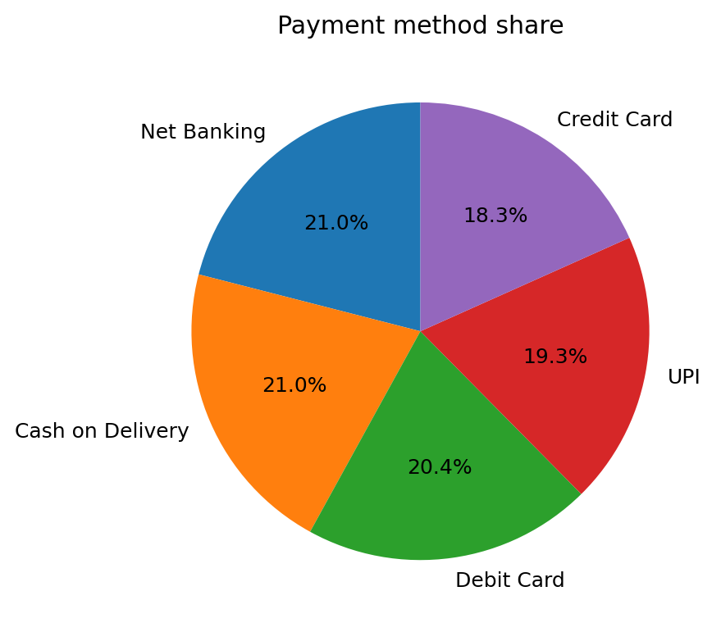
11 / GRAPH 10
Donut chart: payment method share
Easy explanation: see which payment methods are used most often.
How to read this graph
Each slice represents a payment method’s share of records.
A larger slice means that method appears more often.
This measures frequency, not payment amount.
Use it to understand customer payment preferences in this dataset.

Slide 13
12 / FINAL TAKEAWAY
How to choose the right graph
Different graph types answer different questions.
Bar chart
Compare categories
Which category has the highest value?
Lollipop / column
Compare quantities or cities
Which product/city is ahead?
Donut chart
Show shares
How is a total divided?
Line chart
Show change over time
When did sales rise or fall?
Stacked bar
Compare grouped counts
How do statuses vary by category?
Scatter plot
Check relationships
Do discount and order value move together?
Heatmap
Compare two dimensions
Which city-category combinations stand out?
Box plot
Show spread and median
How much do discounts vary?
Data source: flipkart_sales_dataset.csv • figures recalculated from the supplied file

